Slide 1
Scheduling Application
This application allows the remote user to create, read, update, and delete appointments for customers at a home office on the east coast.
The application will locate the user’s current time zone and adjust the list of available appointment times to that time zone.
The home office business hours are 8 AM to 10 PM Eastern Standard Time. If for example the user is in Pacific Standard Time, the list of available appointment times would show as 5 AM to 7 PM.
The application can also create, read, update, and delete customers.
All data is contained within a MySQL database.

Slide 2
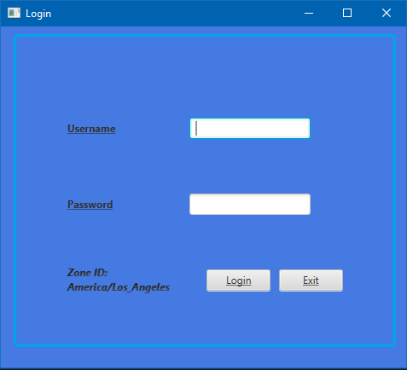
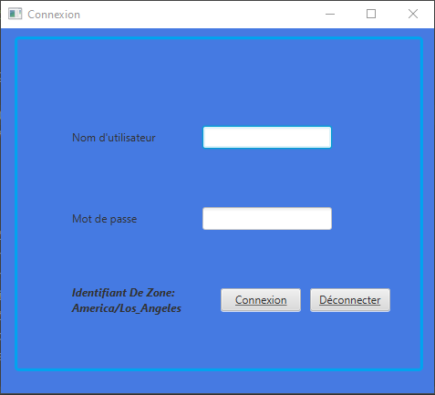
Login Screen
Connects to the database and opens the main menu.
Adjusts to locale of the user. (English and French only for now).

Slide 3
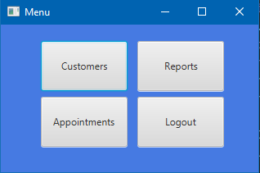
Main Menu
Opens the Customer, Reports, and Schedule screens.

Slide 4
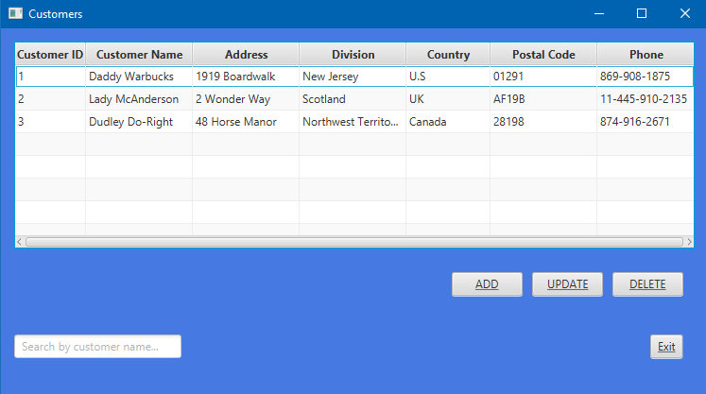
Customer Screen
Adds a new customer or updates/deletes selected customer.
Search available by customer name.

Slide 5
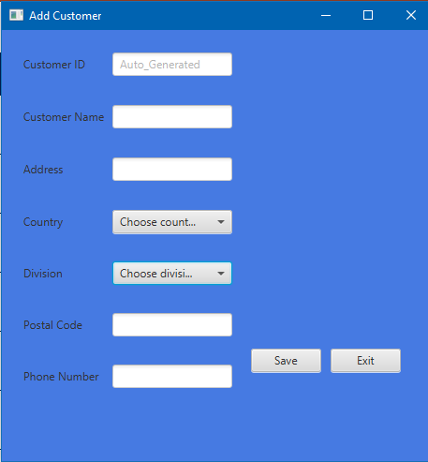
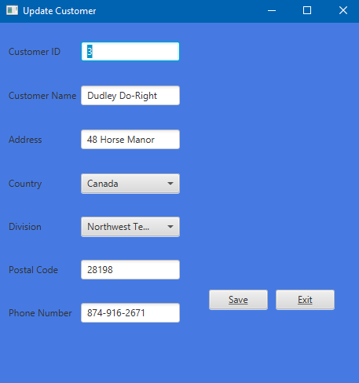
Add/Modify Customer Screens
Add Customer -Adds a new customer to the database and application.
Update Customer -Updates existing customer in the database and application.

Slide 6
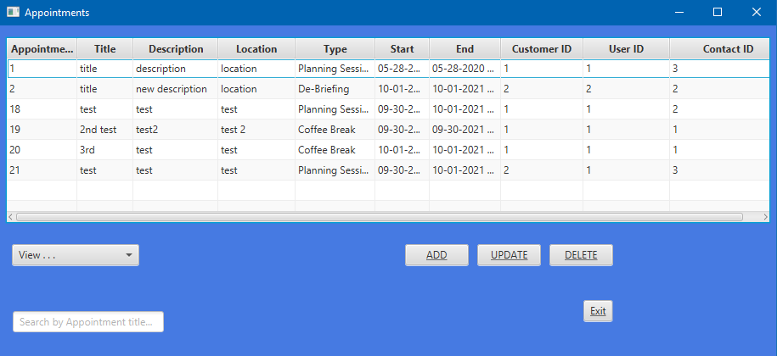
Appointments Screen
Adds a new appointment or updates/deletes selected appointment.
Can be filtered by current week or current month.
Search available by appointment title.

Slide 7
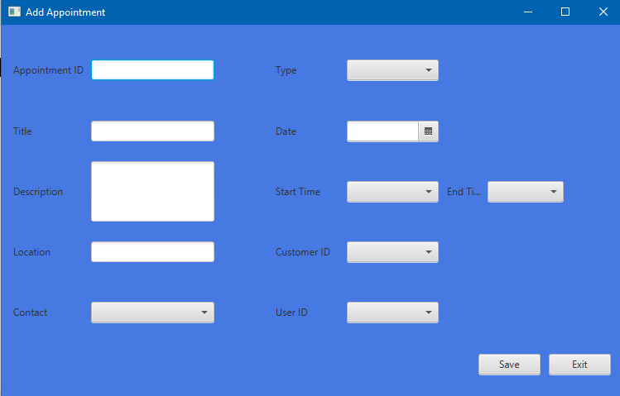
Add Appointment Screen
Adds a new appointment to the database and application.

Slide 8
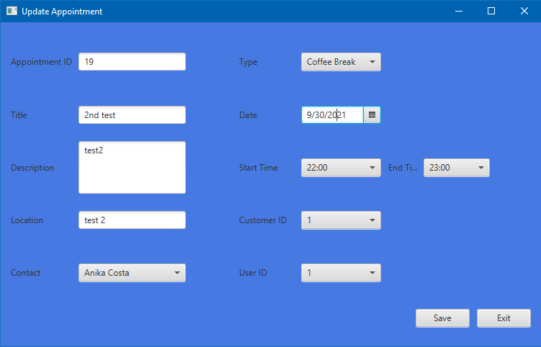
Update Appointment Screen
Updates an appointment in the database and application.

Slide 9
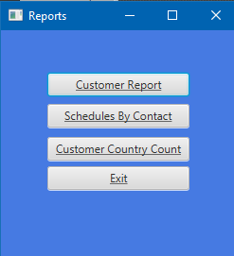
Reports Menu Screen
Opens the Customer Report, Contact Schedules, and Country Count Reports screens.

Slide 10
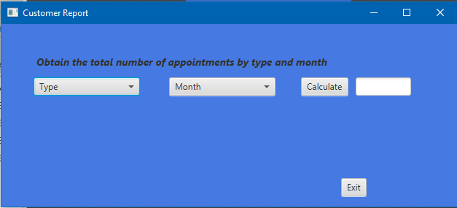
Customer Report Screen
Calculates the total number of appointment by type and month.

Slide 11
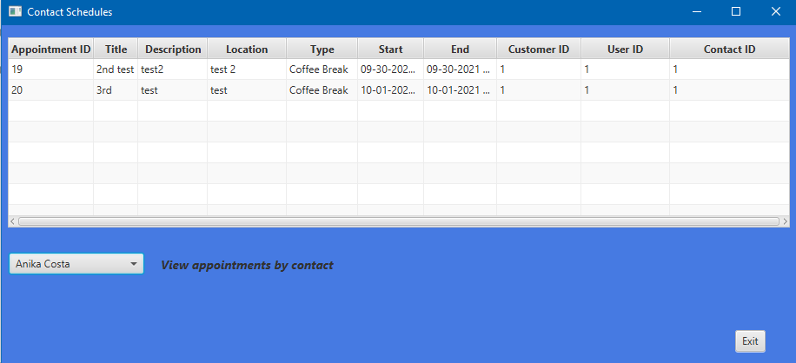
Contact Schedules
Shows each contact’s appointment details.

Slide 12
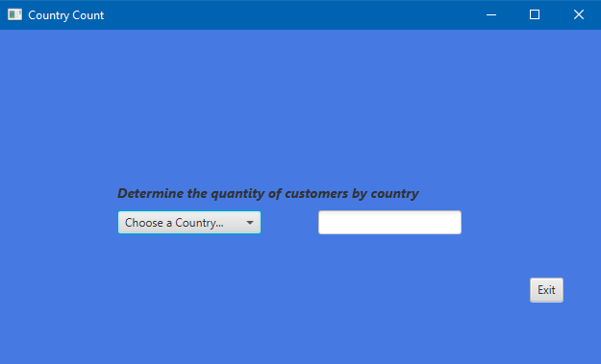
Country Count
Determines the quantity of customers per country.

